Slide 1
Quine’s simplification method

Slide 2
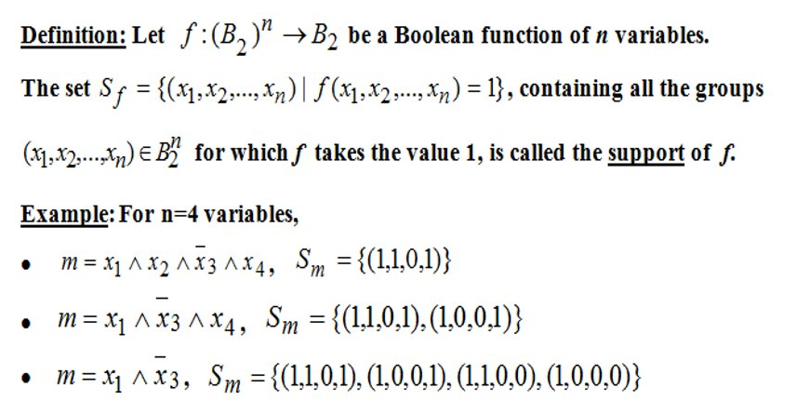
this method helps us simplify functions given in the Disjunctive Canonical Form
steps:
order the support set of f
group minterms in a tableau by the number of 1’s
extend the tableau by factorizing 2 neighbor monoms
use another tableau to find the central monoms
main goal:
- cover all minterms with the least number of max monoms
- avoid overlapping

Slide 3
Exercise 5.1
using Quine’s method, simplify the following Boolean functions given by their values 0.
f1(0,1,0) = f1(0,1,1) = f1(1,0,1) = 0
=>f1(0,0,0) = f1(0,0,1) = f1(1,0,0) = f1(1,1,0) = f1(1,1,1) = 1
DCF (Disjunctive Canonical Form):
f1(x1,x2,x3) = x1x2x3 v x1x2x3 v x1x2x3 v x1x2x3 v x1x2x3
ordering the support set (ascending by number of 1’s):
S_{f} = { (0, 0, 0), (0, 0, 1), (1, 0, 0), (1, 1, 0), (1, 1, 1) }

Slide 4

S_{f} = { (0, 0, 0), (0, 0, 1), (1, 0, 0), (1, 1, 0), (1, 1, 1) }
m0
m1
m4
m7
m0 v m1 = x1x2 = max1
m0 v m4 = x2x3 = max2
m4 v m6 = x1x3 = max3
m6 v m7 = x1x2 = max4
M(f) = {max1, max2, max3, max4}

Slide 5

M(f) = {max1, max2, max3, max4}
max monoms
minterms
there are 2 unique ‘ * ‘ on different rows => max1 and max4 are central monoms
=> C(f) = { max1, max4 }

Slide 6
M(f) = { max1, max2, max3, max4 }
C(f) = { max1, max4 }
M(f) ≠ C(f) and C(f) ≠ ∅ => 2nd case of simplification algorithm
g(x1,x2,x3) = max1 v max4 = x1x2 v x1x2
simplified form ⬄ all minterms are covered ⬄ m4 is covered ⬄ max2 or max3 as h (h covers Sf-Sg) -> 2 simplified
forms:
1) f(x1,x2,x3) = max1 v max4 v max2 = x1x2 v x1x2 v x2x3
2) f(x1,x2,x3) = max1 v max4 v max3 = x1x2 v x1x2 v x1x3

Slide 7
thank

